Slide 1
Co-interior angles
Miss L
Year 7

Slide 2
Learning Intentions
Students will be able to
- Label co-interior angles

Slide 3




Slide 4


Slide 5
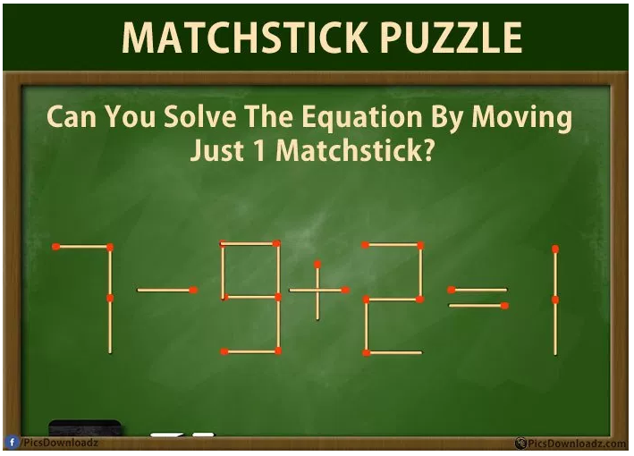
Notes:
Answer: 7-9+3=1

Slide 6
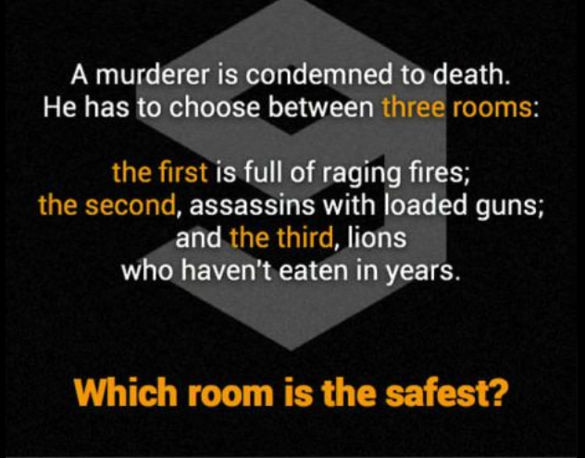
Notes:
The lion room as the lions are all dead….

Slide 7
24
7
30
Topic: Co-Interior Angles
Date:
EQ – What is co-interior angles and how do we find them?
Co-Interior angles are on the same side of the traversal line between the parallel lines.
They are supplementary angles (they add up to 180°)
It forms a C shape
What is a Co-Interior Angle??

Slide 8


Slide 9
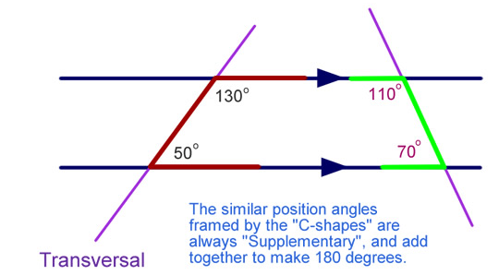
24
7
30
Topic: Co-Interior Angles
Date:
EQ – What is co-interior angles and how do we find them?
What is a Co-Interior Angle??

Slide 10
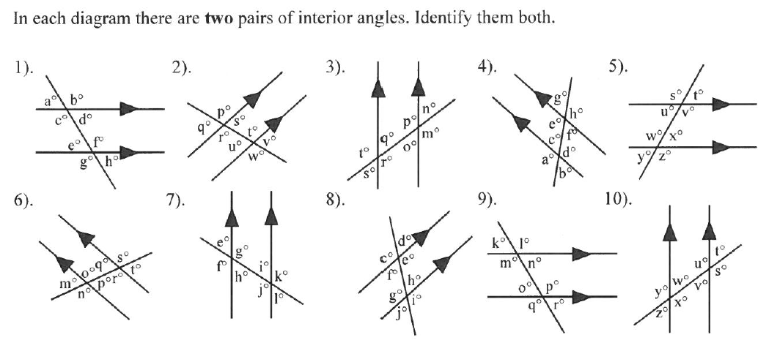
Practice
Notes:
Guide students through the question.
Option 2: Dot plots handout (Scaffolded for kids who may need extra help)

Slide 11
Task
https://create.kahoot.it/#quiz/5ed0e7ba-3de2-41a5-a1cc-f36f3cfda757
https://create.kahoot.it/#quiz/02a9316f-bc38-4257-ae4e-95e5159469a0
https://create.kahoot.it/#quiz/353034e3-b072-4ee7-8051-34f8956c06e8
Notes:
Guide students through the question.
Option 2: Dot plots handout (Scaffolded for kids who may need extra help)

